Slide 1
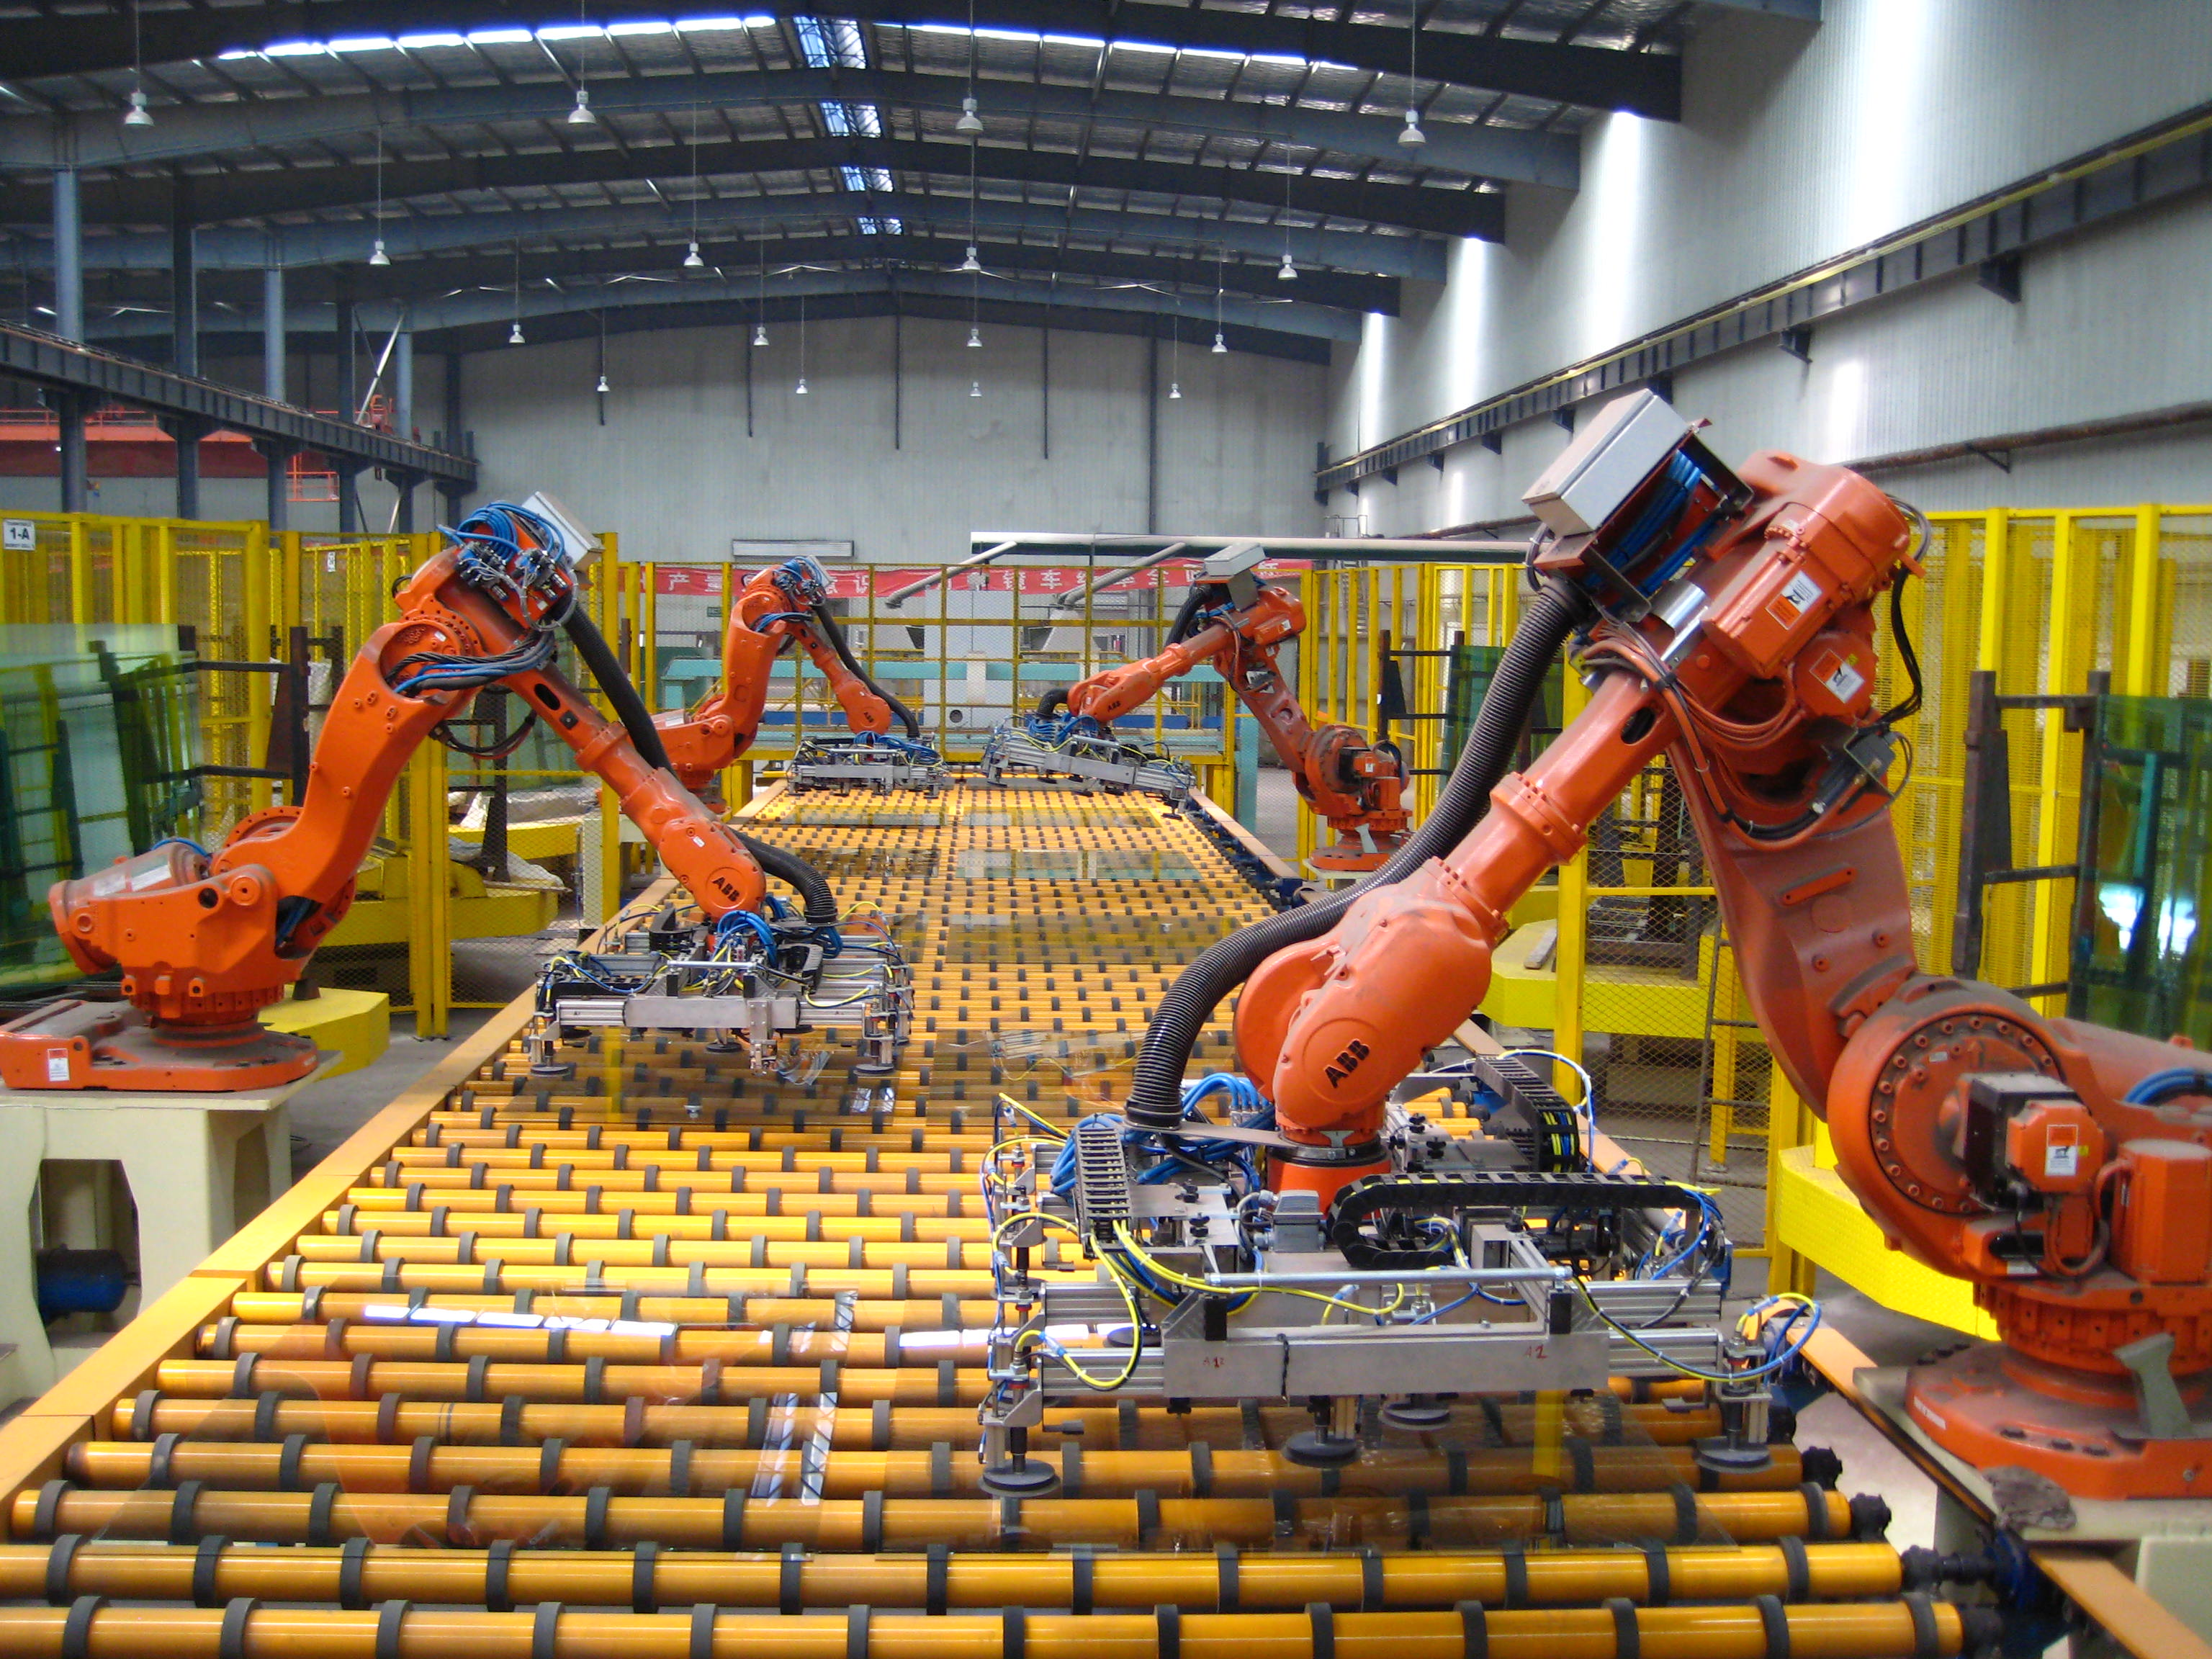

WEEK 7
Edge Hill University
Advanced Robotics and AI CIS3137
Dr. Ammar Al Mhdawi
Ammar.Al-Mhdawi@edgehill.ac.uk

Slide 2
Key to Success
Attendance
Pay attention to lectures and keep extra notes
Ask questions
Effort
Do homework on your own. It’s ok to ask others, but make your own effort
Read extra material on your own. Wealth of information available (library books, online articles, research papers)
Consistency
Keep up with the class pace

Slide 3
Class Expectations
Class participation – Your input is needed for good discussion
Keep up with reading material
Complete assignments and projects on time
Submit clean, organized, and concise CW reports

Slide 4
Contents
1
Robotic Automation in Factories
2
Robotic Automation : Amazon Robotic Family
3
Robotic Automation: Automobile Manufacturing
4
Reinforcement Learning (RL) in Robotics
5
Summary

Slide 5
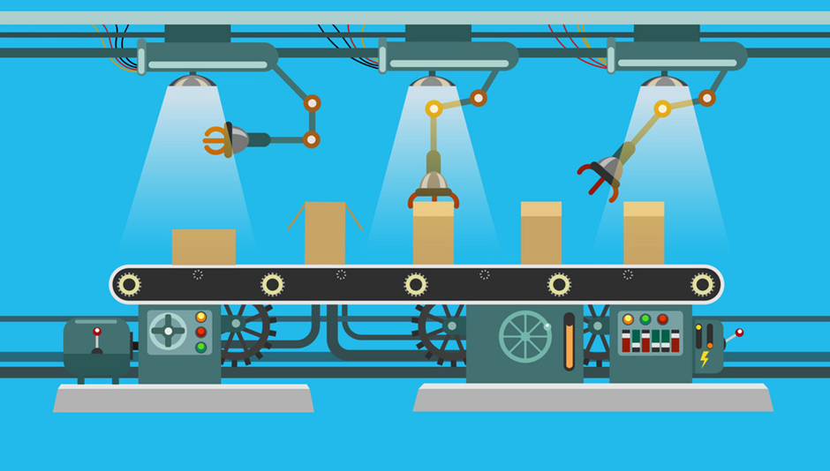
1
Robotic Automation in Factories
The word ‘Automation’ is derived from greek words “Auto”(self) and “Matos” (moving). Automation therefore is the mechanism for systems that “move by itself”. However, apart from this original sense of the word, automated systems also achieve significantly superior performance than what is possible with manual systems, in terms of power, precision and speed of operation.
Automation or automatic control is the use of various control systems for operating equipment such as machinery, processes in factories, boilers and heat-treating ovens, switching on telephone networks, steering and stabilization of ships, aircraft and other applications and vehicles with minimal or reduced human intervention.
Logistics Automation is the application of computer software and/or automated machinery to improve the efficiency of logistics operations.
Typically, this refers to operations within a warehouse or distribution center, with broader tasks undertaken by supply chain management systems and enterprise resource planning systems.

Slide 6
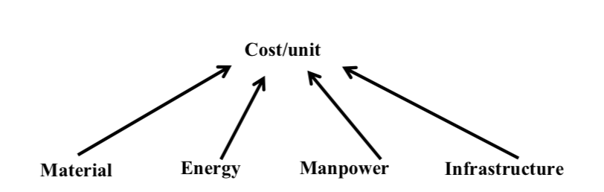
1
Robotic Automation in Factories
Role of automation in industry
Manufacturing processes, basically, produce finished product from raw/unfinished material using energy, manpower and equipment and infrastructure.
Since an industry is essentially a “systematic economic activity”, the fundamental objective of any industry is to make profit.
Roughly speaking, Profit = (Price/unit – Cost/unit) x Production Volume
The profit can be maximised by producing good quality products, which may sell at higher price, in larger volumes with less production cost and time

Slide 7
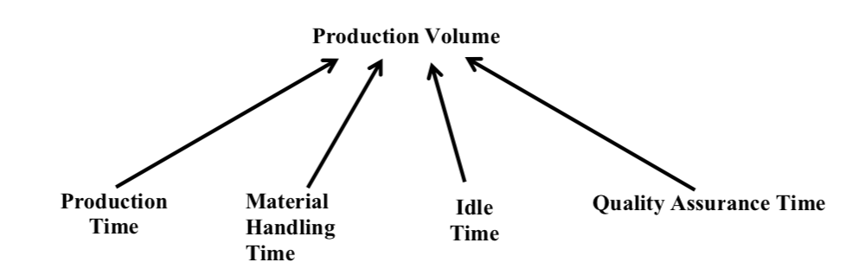
1
Robotic Automation in Factories
Role of automation in industry (Continued)
Automated machines have significantly lower production times. For example, in machine tools, manufacturing a variety of parts, significant setup times are needed for setting the operational configuration and parameters whenever a new part is loaded into the machine. This can lead to significant unproductive for expensive machines when a variety of products is manufactured
Similarly, systems such as Automated Guided Vehicles, Industrial Robots, Automated Crane and Conveyor Systems reduce material handling time.
Automation also reduces cost of production significantly by efficient usage of energy, manpower and material.
The product quality that can be achieved with automated precision machines and processes cannot be achieved with manual operations.

Slide 8
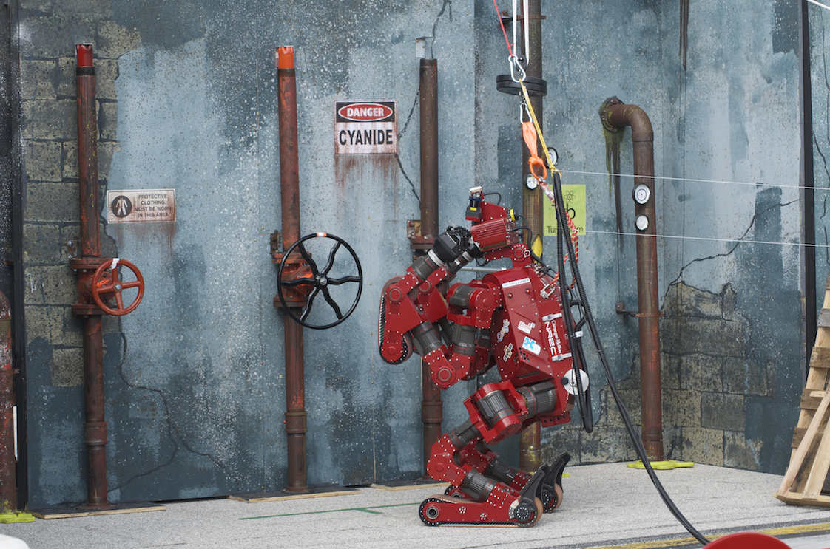
1
Robotic Automation in Factories
Importance of robotics in industry
Improved Productivity: Automation increases efficiency on the factory floor. This is because robots and machinery dedicated to specific tasks can increase production rate and labour output. They can do more per hour and are capable of handling heavy loads with ease.
Specific Task Handling: Some tasks are difficult or impossible to perform by human workers, so automation can accomplish certain processes that cannot be done manually. This is usually because they’re too intricate and precise; rapid prototyping is one of them, as it’s too complex to be performed by anything other than a computer.
Cost Reduction: it allows products to be manufactured a lot quicker and easier, saving time and money in the process.
Error Reduction: automation not only speeds up the manufacturing process but also has better repeatability and makes fewer errors
Performs Complex and Dangerous Tasks: it prevents employees from having to perform dangerous tasks that can cause them injury. The work environment will become safer and, therefore, there will be fewer workplace accidents.
A robot performing dangerous task
Source: Making Sense of robot sensors – National Geographic

Slide 9
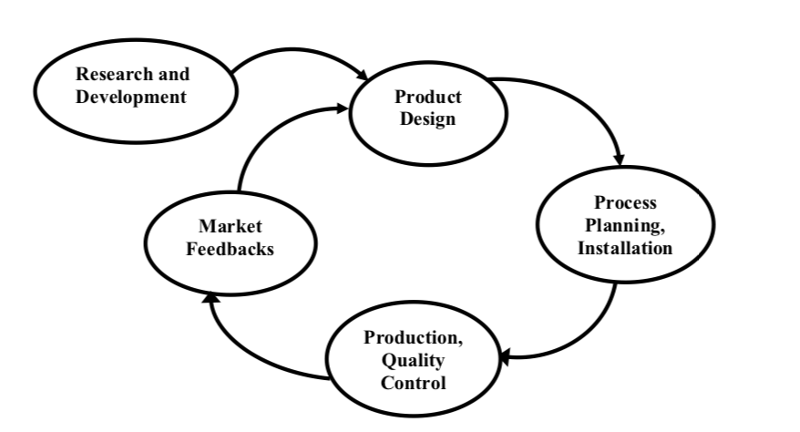
1
Robotic Automation in Factories
Industrial products life cycle
At first, a product is conceived based on Market feedbacks, as well as Research and
Development Activities.
Once conceived the product is designed. Prototype Manufacturing is generally needed to prove the design.
Once the design is proved, Production Planning and Installation must be carried out to ensure that the necessary resources and strategies for mass manufacturing are in place.
This is followed by the actual manufacture and quality control activities through which the product is mass-produced.
This is followed by a number of commercial activities through which the product is actually sold in the market.
Automation also reduces the over all product life cycle i.e., the time required to complete (i) Product conception and design (ii) Process planning and installation (iii).

Slide 10
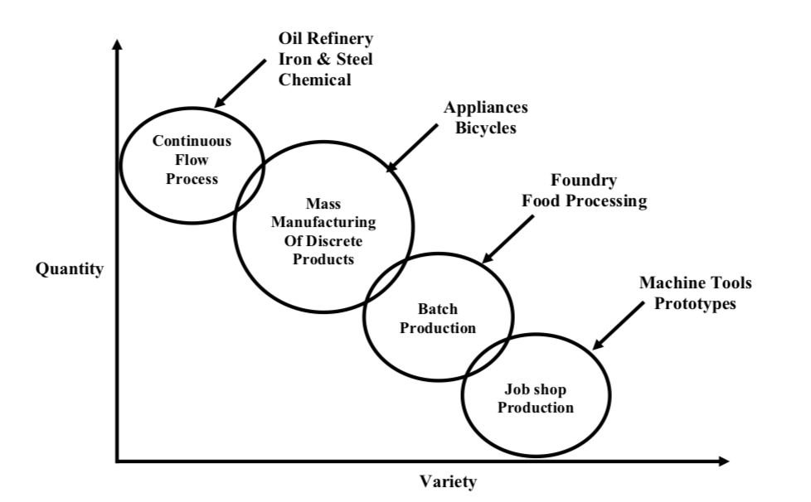
1
Robotic Automation in Factories
Types of industrial robotic factory production system
Continuous flow process: Manufactured product is in continuous quantities i.e.; the product is not a discrete object. Moreover, for such processes, the volume of production is generally very high, while the product variation is relatively low. Typical examples of such processes include Oil Refineries, Iron and Steel Plants, Cement and Chemical Plants.
Mass Manufacturing of Discrete Products: Products are discrete objects and manufactured in large volumes. Product variation is very limited. Typical examples are Appliances, Automobiles etc.
Batch Production: In a batch production process the product is either discrete or continuous. However, the variation in product types is larger than in continuous-flow processes. The same set of equipment is used to manufacture all the product types. However, for each batch of a given product type a distinct set of operating parameters must be established. This set is often referred to as the “recipe” for the batch. Typical examples here would be Pharmaceuticals, Casting Foundries, Plastic moulding, Printing etc.
Job shop Production: Typically designed for manufacturing small quantities of discrete products, which are custom built, generally according to drawings supplied by customers. Any variation in the product can be made. Examples include Machine Shops, Prototyping facilities etc.

Slide 11
1
Robotic Automation in Factories
Types of Automation Systems
Fixed Automation: It is used in high volume production with dedicated equipment, which has a fixed set of operation and designed to be efficient for this set. Continuous flow and Discrete Mass Production systems use this automation. e.g. Distillation Process, Conveyors, Paint Shops, Transfer lines etc.
Programmable Automation: It is used for a changeable sequence of operation and configuration of the machines using electronic controls. However, non-trivial programming effort may be needed to reprogram the machine or sequence of operations.
Flexible Automation: It is used in Flexible Manufacturing Systems (FMS) which is invariably computer controlled. Human operators give high-level commands in the form of codes entered in computer identifying product and its location in the sequence and the lower-level changes are done automatically. Each production machine receives settings/instructions from computer. These automatically loads/unloads required tools and carries out their processing instructions. After processing, products are automatically transferred to next machine.
Integrated Automation: It denotes complete automation of a manufacturing plant, with all processes functioning under computer control and under coordination through digital information processing. It includes technologies such as computer-aided design and manufacturing, computer-aided process planning, computer numerical control machine tools, flexible machining systems, automated storage and retrieval systems, automated material handling systems such as robots and automated cranes and conveyors, computerized scheduling and production control.

Slide 12
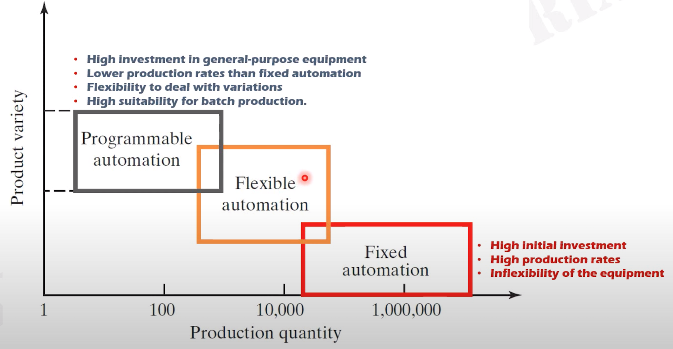
1
Robotic Automation in Factories
Types of Automation Systems (Continued)

Slide 13
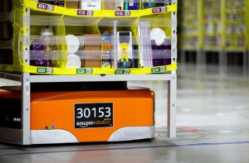
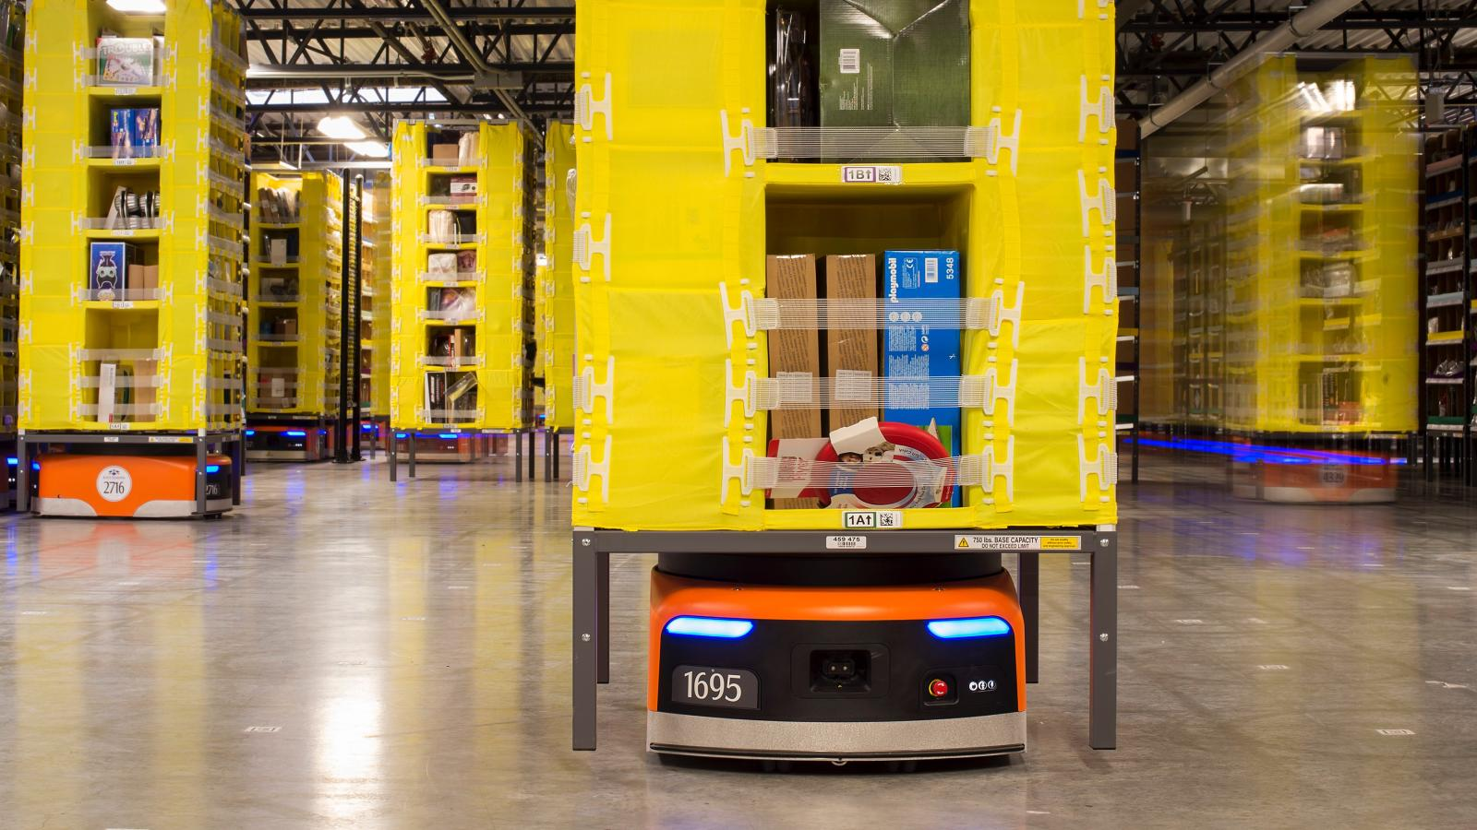
2
Robotic Automation : Amazon Robotic Family
Kiva system
The original Kiva is pretty much the robot that Kiva supplied to Amazon, back then called DU 1000 for a driving unit with 1000 pounds lifting capacity
This robot moves shelves (called pods) around for faster and cheaper stowing and picking.
It is about 75cm long and 60 cm wide (2.5 by 2 feet), and fits nicely underneath a pod that measures roughly 1x1m
It is 30cm (1 foot) high, weighs around 110kg (250 pounds) and can lift 450kg (1000 pounds)
Like most of the robots here, it has a speed of 5 km/h (3 miles per hour), or comfortable walking speed.

Slide 14
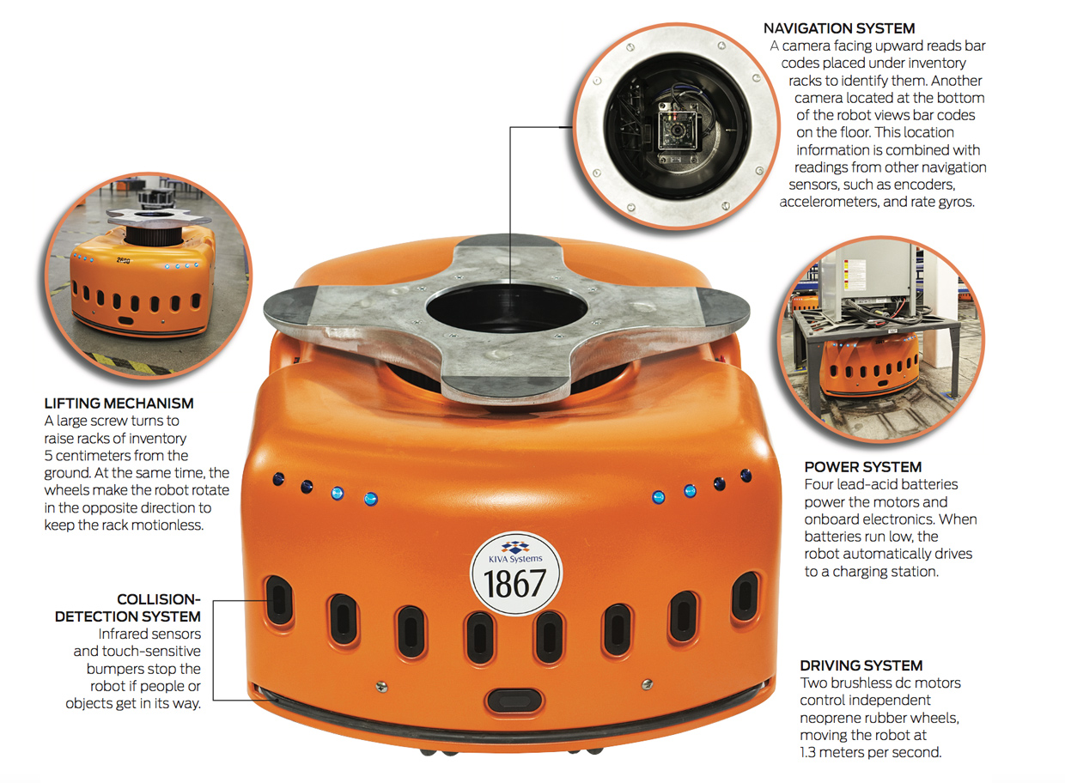
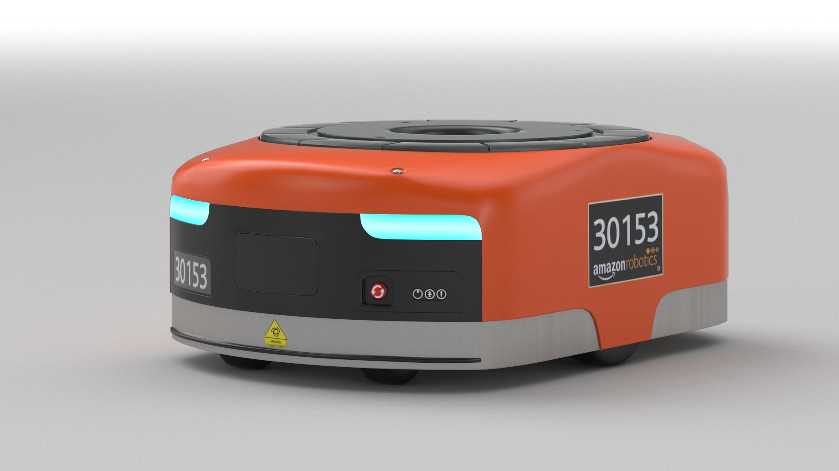
2
Robotic Automation : Amazon Robotic Family
Kiva system

Slide 15
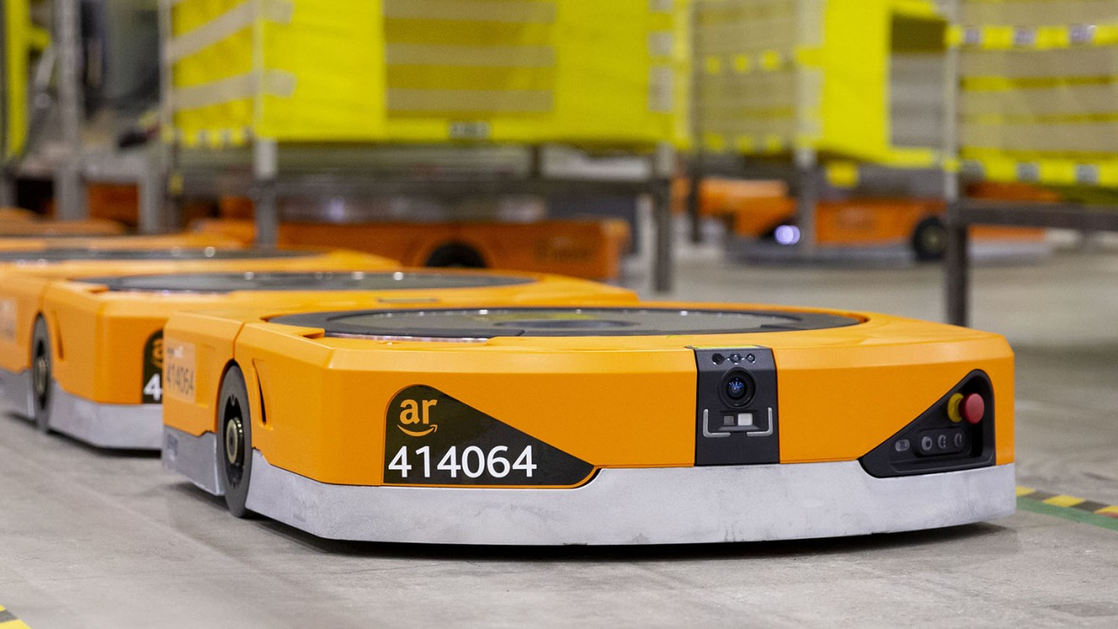
2
Robotic Automation : Amazon Robotic Family
Hercules system
The Hercules also dates back to the original Kiva Systems development introduced in 2007
Back then it was called DU 3000 as a driving unit with 3000-pound lifting capacity
t is designed for heavy-duty lifting. The principle is like it smaller cousin, but Hercules can lift much more weight
It is larger in all dimensions, and therefore the pods are also larger
There are also pallet-pods, which are pallets on a frame with legs for the robot to go underneath.
Pegasus system
The successor to the original Kiva is named Pegasus after the mythical winged horse
It performs the same function as the original Kiva and moves pods around. However, it is only 19 cm high, 10cm less than the original Kiva
This means 10cm more space to store stuff! It can also lift 560kg, a bit more than the old one with 450kg.
The Pegasus helps to fit more stuff into a warehouse to reduce investment cost

Slide 16
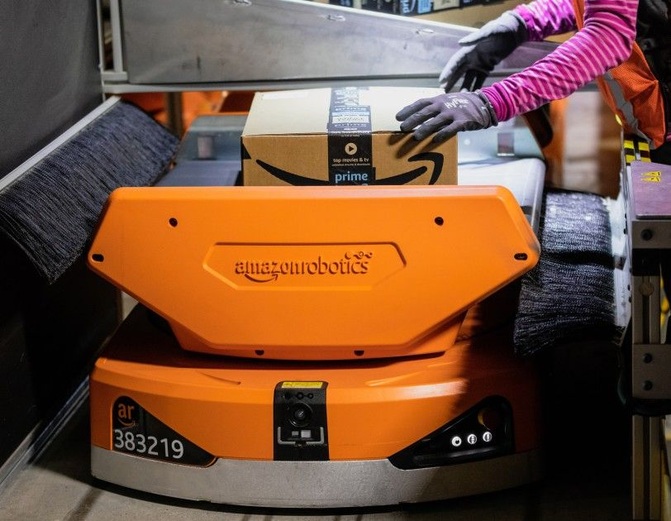
2
Robotic Automation : Amazon Robotic Family
Pegasus system : X-Sort Drive
The Pegasus is also intended to be a generic base for different attachments on top
One such an attachment is the X-Sort Drive, basically half a meter of conveyor belt.
This robot has a completely different purpose and does not carry pods
Instead, it is used to sort, and transport completed parcels to shipping
After labelling (called SLAM), a worker places the parcel on the robot. The robot knows which truck the parcel goes to and moves to the corresponding chute
At the chute, the conveyor belt simply throws the parcel into the chute

Slide 17

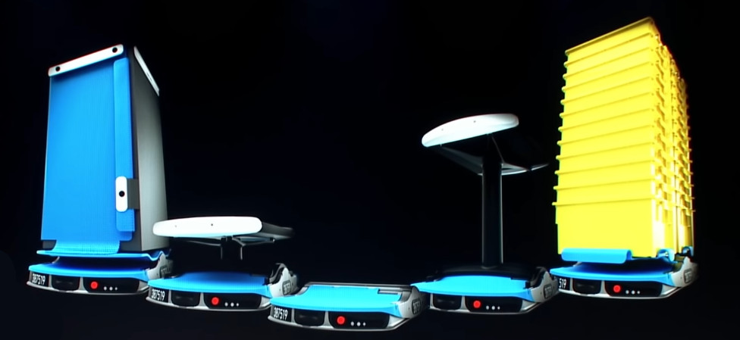
2
Robotic Automation : Amazon Robotic Family
Xanthus system
Xanthus, is the successor to Amazon’s current Pegasus robot
Xanthus is a drive unit – a type of robot used for moving heavy inventory – and can be equipped with a variety of modules to perform different tasks.
The Xanthus is much thinner, has one-third the number of parts, and costs half as much as the original Kiva.
Since it has less parts, it is also easier to maintain.

Slide 18
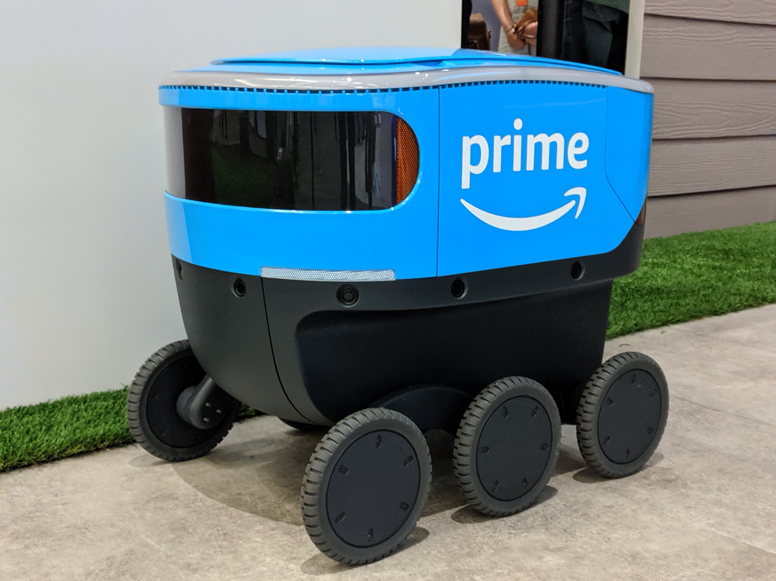
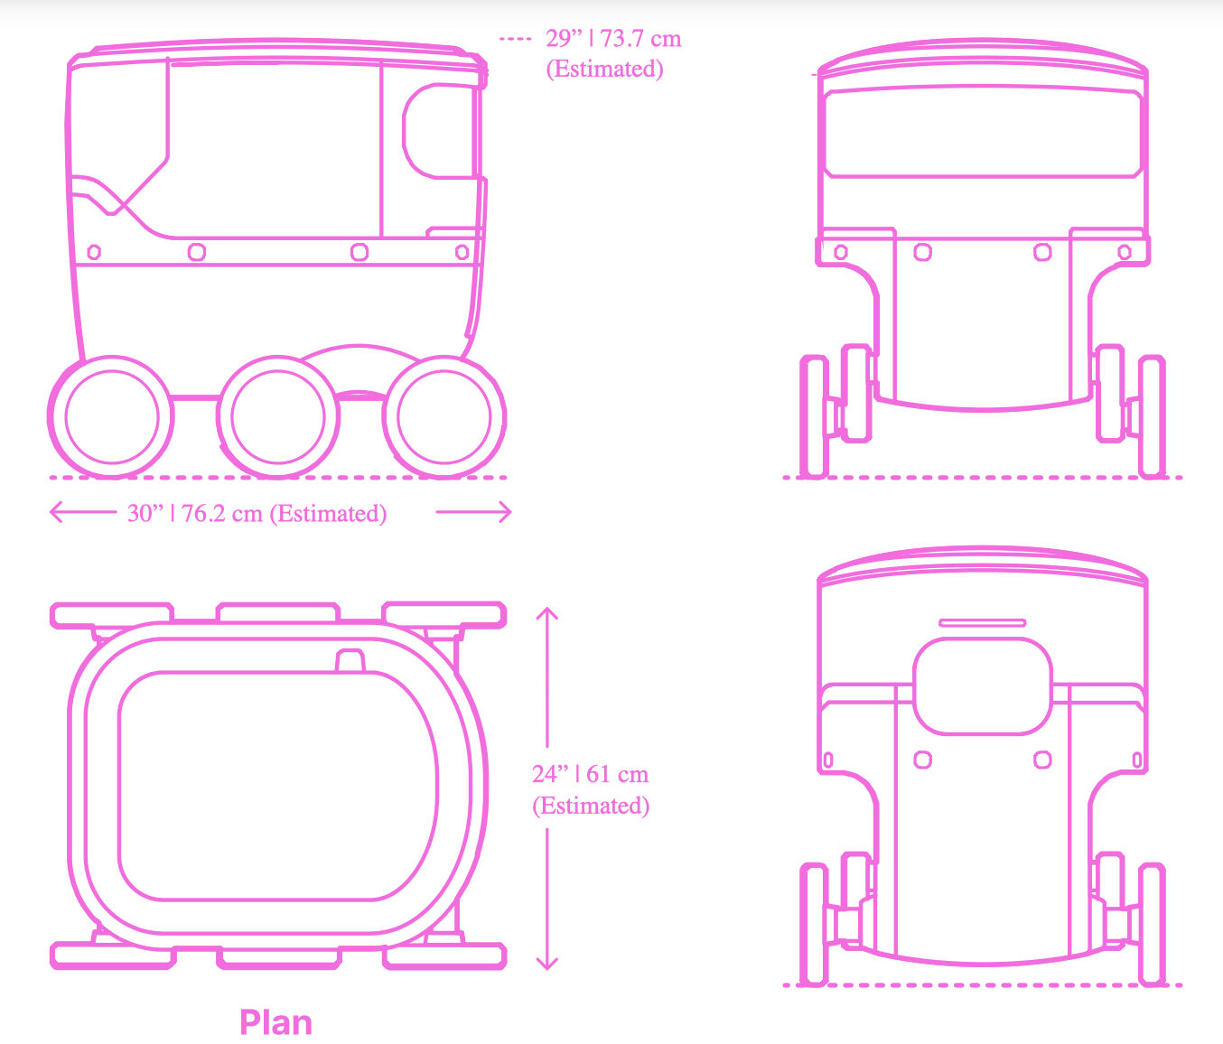
2
Robotic Automation : Amazon Robotic Family
Amazon Scout
is a 6 wheeled robot used to deliver the parcels the last mile from the fulfilment centre to the customer
The Amazon Scout has an estimated total length of 30” (76.2 cm), estimated width of 24” (61 cm), and estimated height of 29” (73.7 cm)
Amazon Scouts weigh 100 lb (45 kg) and can carry a payload of 50 lb (23 kg)
The maximum movement speed of the Amazon Scout is 15 mph (24 km/h).

Slide 19
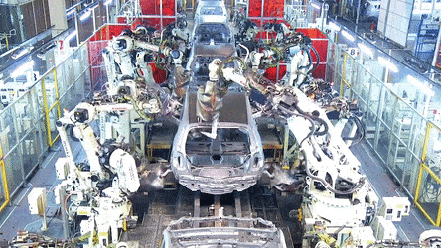
3
Robotic Automation : Automobile Manufacturing
Car manufacturing robots give automotive companies a competitive advantage
They improve quality and reduce warranty costs; increase capacity and relieve bottlenecks; and protect workers from difficult and dangerous tasks
Car assembly plants use robots exclusively for spot welding and painting, but there are many other opportunities to use robots throughout the supply chain
It can add Flexibility as follows:
Minimal changeover time from one job to the next
Ability to switch between multiple tasks at the same time: Whether it’s car assembly line robots, spot welding different vehicle bod, robots have the flexibility to switch almost instantly

Slide 20
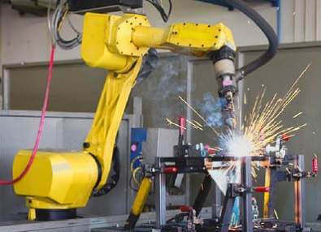
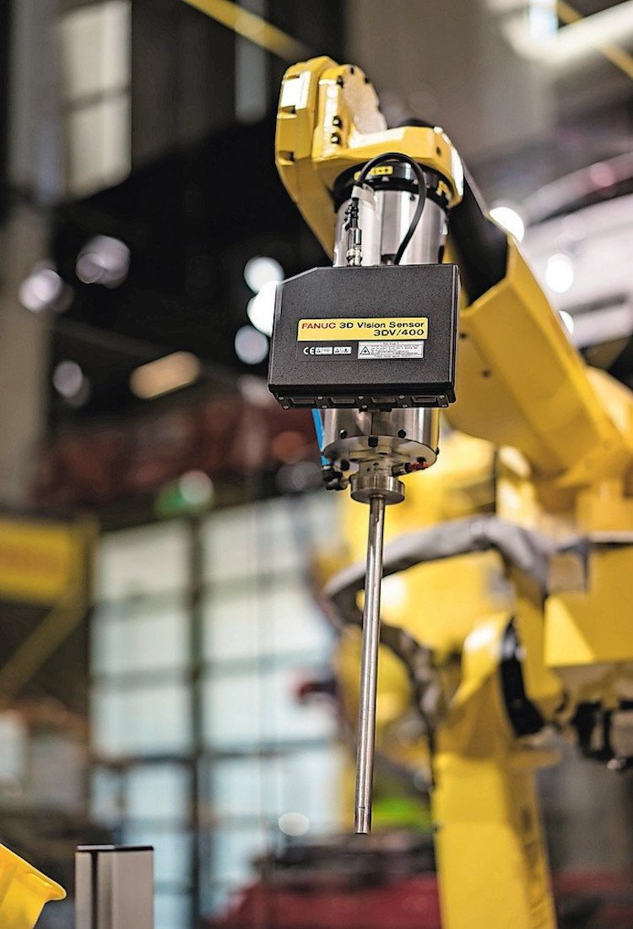
3
Robotic Automation : Automobile Manufacturing
Automotive Robot Tasks
Welding: Large robots with high payload capabilities and long reach can spot weld car body panels; while smaller robots weld subassemblies such as brackets and mounts. Robotic arc welding position is implemented in the same orientation on every cycle, and repeatable speed to ensure manufacturing to high standards.
Assembly: Tasks such as screw driving, windshield installation and wheel mounting are all candidates for robotic arms in car manufacturing plants. In many automotive part plants, robots — for example, the high-speed “Delta” machines — are assembling smaller component assemblies such as pumps and motors.
Material Removal: Because it can follow a complex path repeatedly, a robot is an ideal tool for light trimming and cutting tasks. Examples include cutting fabrics such as headliners, trimming flash from plastic moldings and die castings, and polishing molds. Force-sensing technology lets the robot maintain constant pressure against a surface in applications like these.

Slide 21
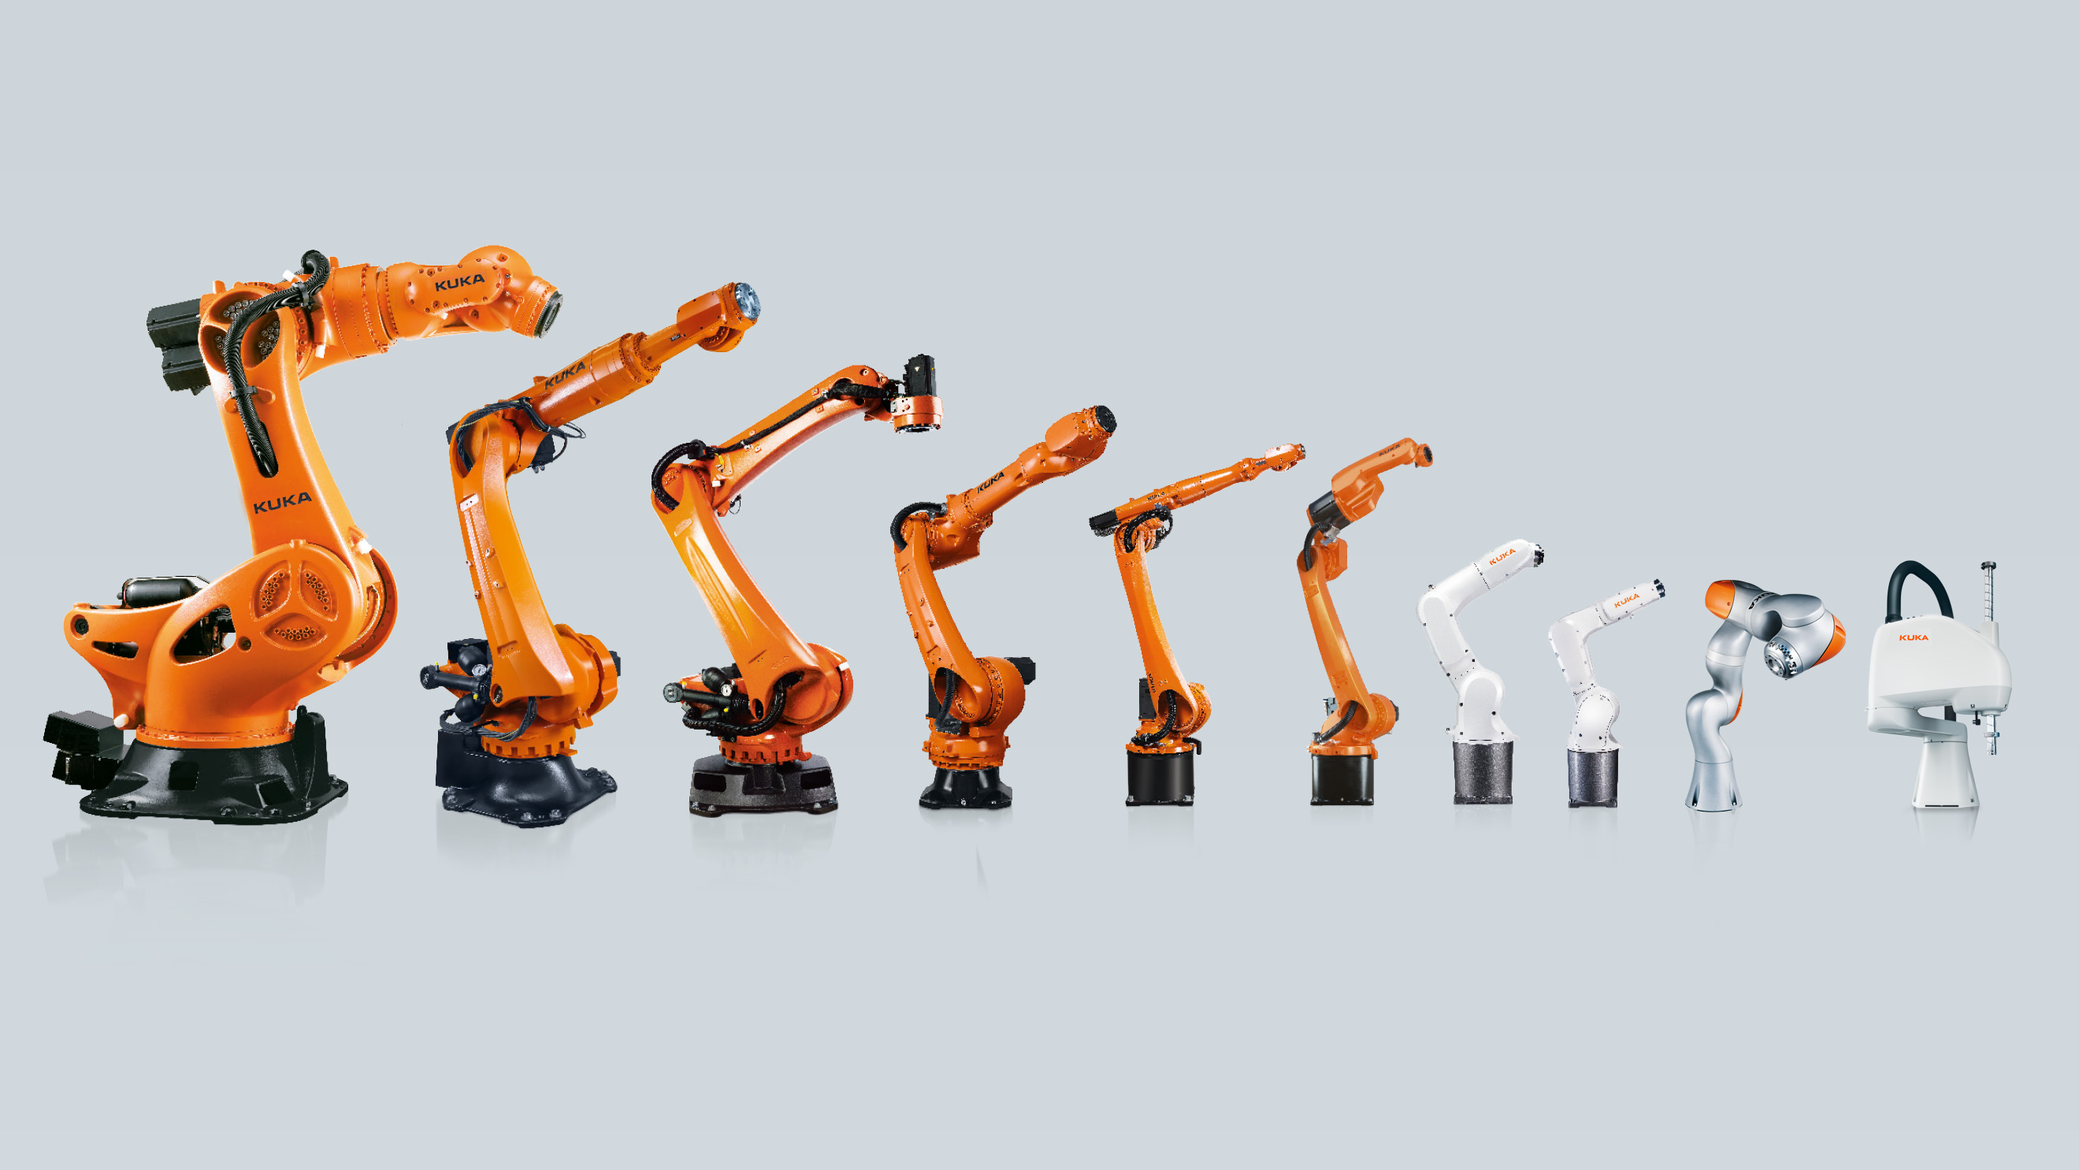
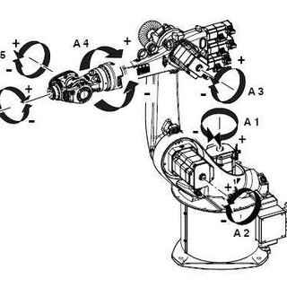
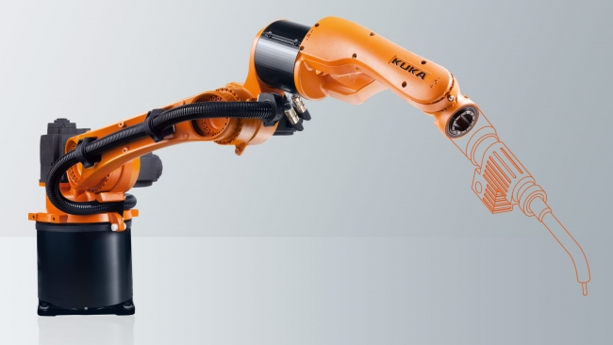
3
Robotic Automation : Automobile Manufacturing
KUKA industrial robot
KUKA offers a comprehensive range of industrial robots according to payload, reach and task type
In this lecture, we will overview the KR CyberTech model
The powerful multi-function robots of the KR CYBERTECH series are specialized in handling applications: for handling large components, machining, assembly, palletizing and arc welding.
It can handle payload of 8-22 Kg, with reach capability of 1612-2013 mm
It provide high precision machining accuracy
it is designed with 47% reduction in volume compared with the predecessor designs.

Slide 22
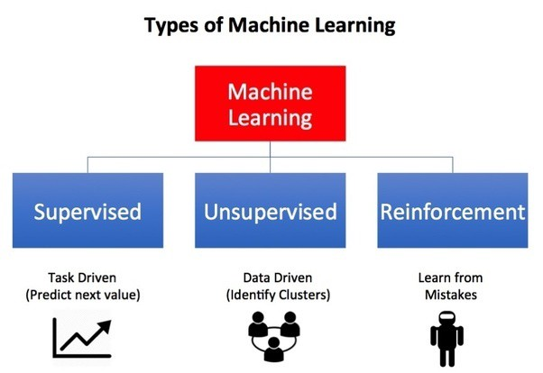
4
Reinforcement Learning (RL) in Robotics
Reinforcement Learning(RL) is a type of machine learning technique that enables an agent to learn in an interactive environment by trial and error using feedback from its own actions and experiences.
Reinforcement Learning teaches an agent how to choose an action from its action space, within a particular environment, in order to maximize rewards over time.
Reinforcement learning algorithms sometimes must wait a while to see the fruit of their decisions. They operate in a delayed return environment, where it can be difficult to understand which action leads to which outcome over many time steps.
Application of RL is in Autonomous vehicles, and autonomous robotic applications.
RL can be combined with ANN to provide efficient intelligent system that can self learn without supervision.

Slide 23

4
Reinforcement Learning (RL) in Robotics
Reinforcement learning uses rewards and punishments as signals for positive and negative behaviour.
In the case of reinforcement learning the goal is to find a suitable action model that would maximize the total cumulative reward of the agent.
The basic elements of an RL problem are:
Environment — Physical world in which the agent operates
State — Current situation of the agent
Reward — Feedback from the environment
Policy — Method to map agent’s state to actions
Value — Future reward that an agent would receive by taking an action in a particular state

Slide 24
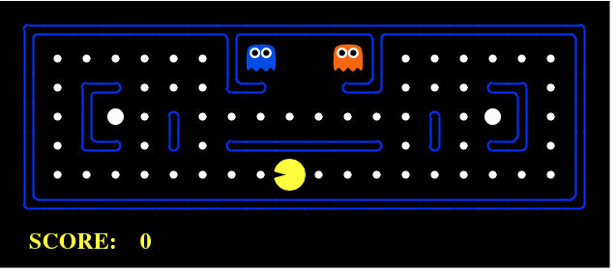
4
Reinforcement Learning (RL) in Robotics
The PacMan game is an example of how RL works. The goal of the agent(PacMan) is to eat the food in the grid while avoiding the ghosts on its way. In this case, the grid world is the interactive environment for the agent where it acts. Agent receives a reward for eating food and punishment if it gets killed by the ghost (loses the game). The states are the location of the agent in the grid world and the total cumulative reward is the agent winning the game.

Slide 25
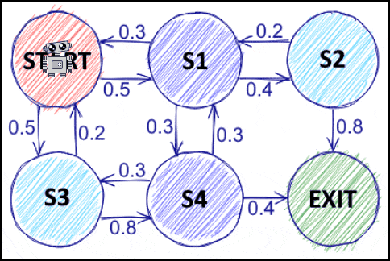
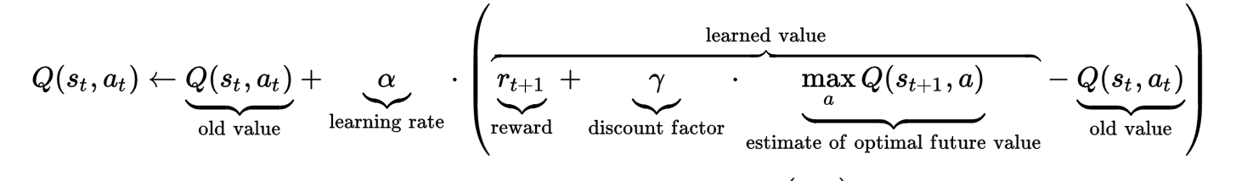
4
Reinforcement Learning (RL) in Robotics
Markov Decision Processes(MDPs) are mathematical frameworks to describe an environment in RL and almost all RL problems can be formulated using MDPs. It provides a mathematical framework for modelling decision making in situations where outcomes are partly random and partly under the control of a decision maker
An MDP consists of a set of finite environment states S, a set of possible actions A(s) in each state, a real valued reward function R(s) and a transition model P(s’, s | a). However, real world environments are more likely to lack any prior knowledge of environment dynamics.
Q-learning is a commonly used model-free approach which can be used for building a self-playing PacMan agent. It revolves around the notion of updating Q values which denotes value of performing action a in state s. The following value update rule is the core of the Q-learning algorithm.

Slide 26
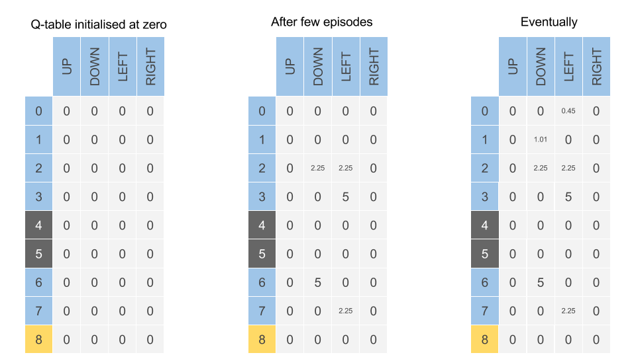
4
Reinforcement Learning (RL) in Robotics
Q-learning is an off policy reinforcement learning algorithm that seeks to find the best action to take given the current state. It’s considered off-policy because the q-learning function learns from actions that are outside the current policy, like taking random actions, and therefore a policy isn’t needed. More specifically, q-learning seeks to learn a policy that maximizes the total reward.
The ‘q’ in q-learning stands for quality. Quality in this case represents how useful a given action is in gaining some future reward.
When q-learning is performed we create what’s called a q-table or matrix that follows the shape of [state, action] and we initialize our values to zero. We then update and store our q-values after an episode. This q-table becomes a reference table for our agent to select the best action based on the q-value.

Slide 27
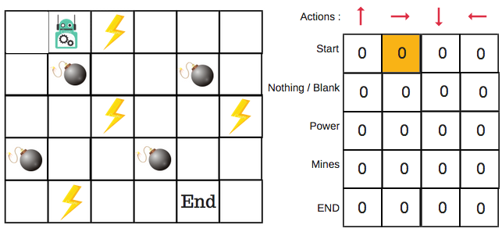
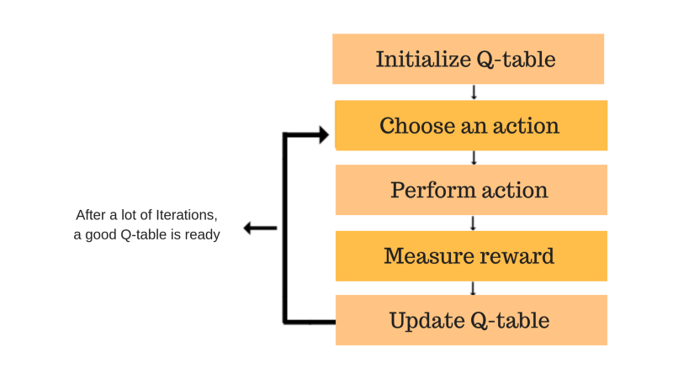
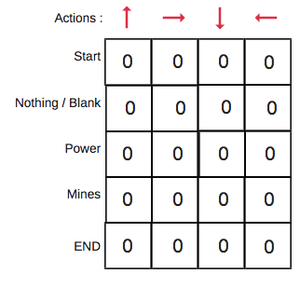
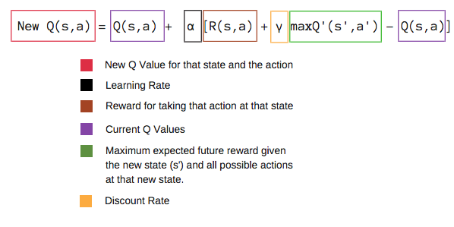
4
Reinforcement Learning (RL) in Robotics
Q-Learning — a simplistic overview
There will be four numbers of actions at each non-edge tile. When a robot is at a state it can either move up or down or right or left.
Initially all entries are set to zero
The robot will explore the environment and randomly choose actions. The logic behind this is that the robot does not know anything about the environment.
As the robot explores the environment, the epsilon rate decreases, and the robot starts to exploit the environment.
The robot chooses a random action, say right.
update the Q-values for being at the start and moving right using the Bellman equation.
We will repeat this again and again until the learning is stopped. In this way the Q-Table will be updated.

Slide 28
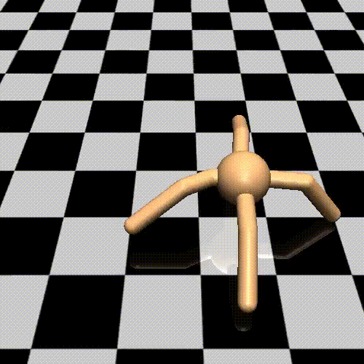
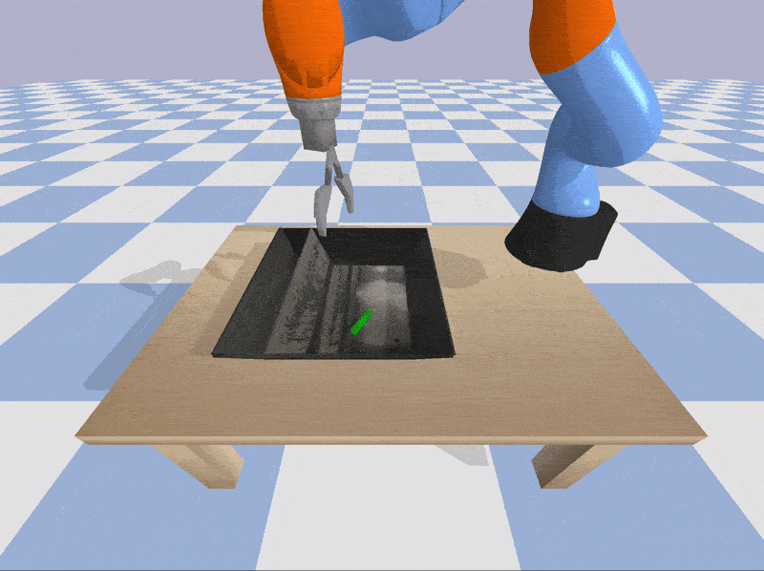
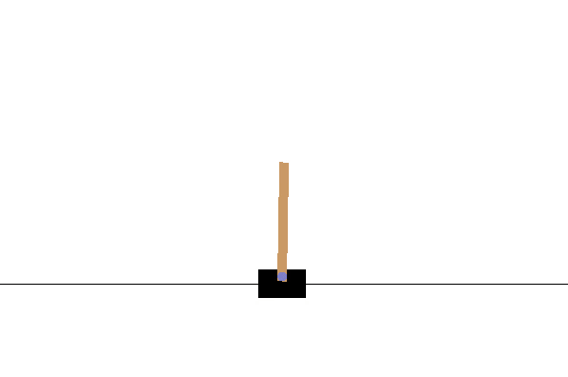
4
Reinforcement Learning (RL) in Robotics
An Introduction to OpenAI Gym
OpenAI Gym is a toolkit for developing and comparing reinforcement learning algorithms. It supports teaching robotic agents walking or performing specific task.

Slide 29
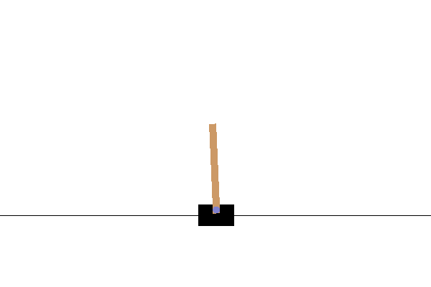
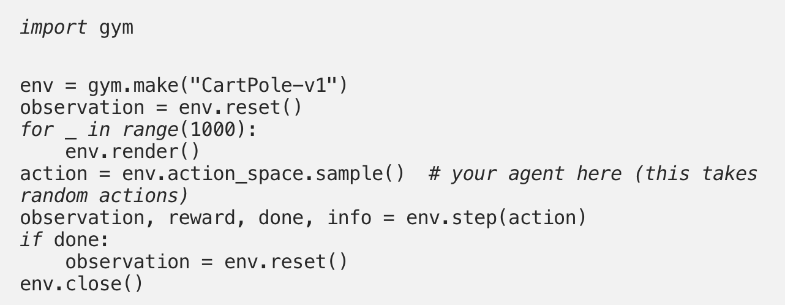
4
Reinforcement Learning (RL) in Robotics
The full OpenAI Gym Episodes and examples are : https://gym.openai.com
The episodes involves : Robotics, Classic Control and Atari Games
STEPS
-Create a ”CartPole” environment.
-Initializes the status parameters.
-Display the environment.
-Prompt an action with a policy that is ‘random’.
-An action is taken and the environment gives four returns: Observation or status : Angle of the pole, Reward: score, Done: game is over or not over.

Slide 30
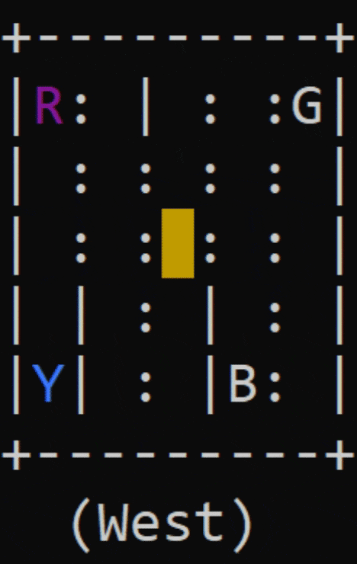
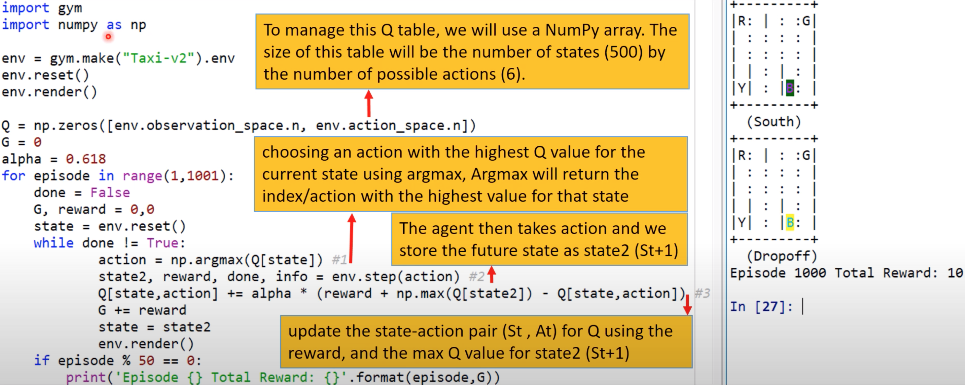
4
Reinforcement Learning (RL) in Robotics
Autonomous Taxi with Q-learning
There are 4 locations (labelled by different letters) and your job is to pick up the passenger at one location and drop him off in another. You receive +20 points for a successful drop-off and lose 1 point for every timestep it takes. There is also a 10-point penalty for illegal pick-up and drop-off actions. Think of this example as a robot autonomous vehicle.

Slide 31
5
Summary
Discussed role of automation in the industry
Discussed the importance of automation in the manufacturing
Discussed industrial products life cycle
Discussed type of production systems
Discussed types of automation systems: Amazon robotic family
Discussed Kuka manipulator system in manufacturing systems
Discussed RL algorithm and its application in the industry

Slide 32
THANK YOU
ANY QUESTIONS?

